Slide 1
Neurosciences (Lab)
Andrey Andreev (450A)

Slide 2
Projects
Project I: Numerical simulation of a model neuron
Project II: Methods for analysis of EEG data

Slide 3
Project I
1. Description of a neuron, numerical simulation of a model neuron: solving the system of differential equations using the Runge Kutta 4th order method, analyzing the correctness of choosing the time step.
2. Analyzing different regimes of a neuron dynamics, plotting time series and phase portraits of the signal, calculation of a regime map.
3. Adding Gaussian noise to the system, solving the system of differential equations with noise, analyzing the influence of noise amplitude on the system dynamics.
4. Adding the coupling between 2 neurons, analyzing synchronization between neurons for different values of the coupling strength.
5. Simulation of a neural network with global topology, analyzing the influence of external stimulus and noise amplitude by calculating characteristic correlation time.

Slide 4
Neuron models
Hodgkin-Huxley model
FitzHugh-Nagumo model
Hindmarsh–Rose model
Morris–Lecar model
Izhikevich Neuron model
Leaky integrate-and-fire model
Special project

Slide 5
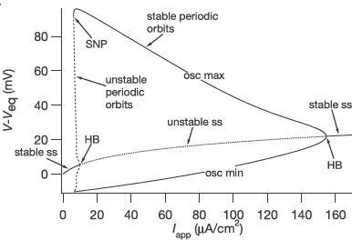

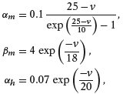
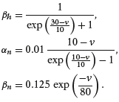
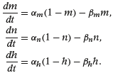
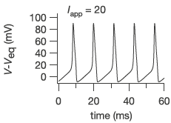

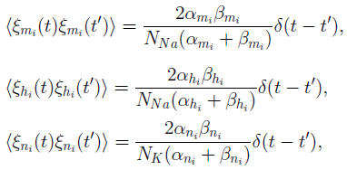
Hodgkin-Huxley model

Slide 6
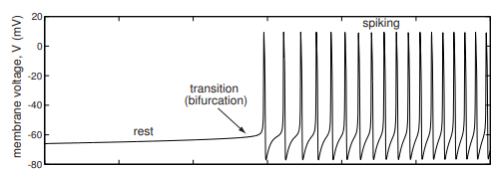

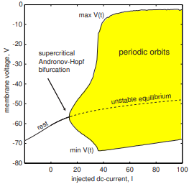
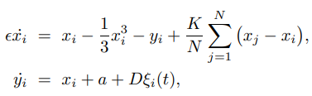
FitzHugh-Nagumo model

Slide 7
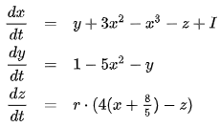
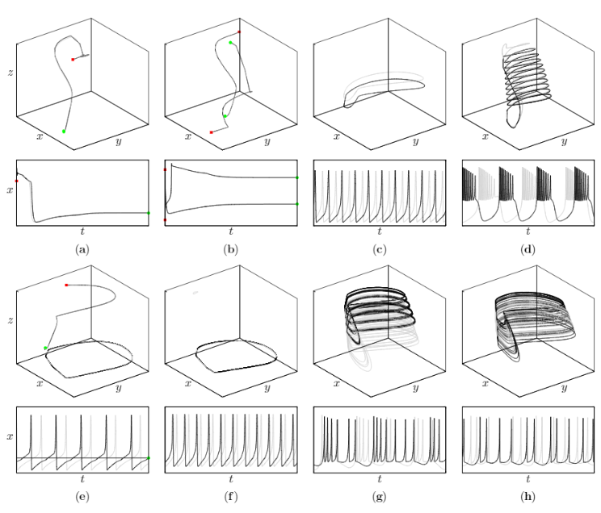
Hindmarsh–Rose model

Slide 8
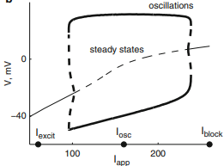

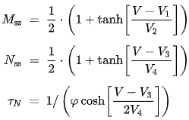
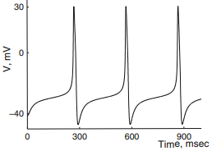
Morris–Lecar model

Slide 9
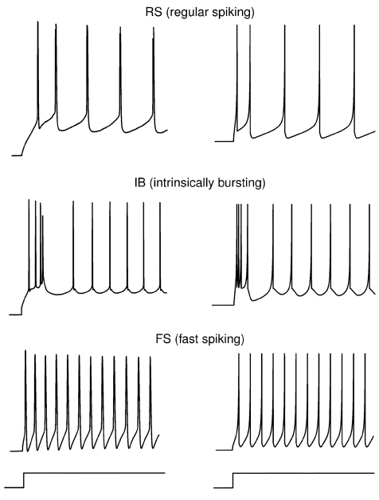

Izhikevich Neuron model

Slide 10
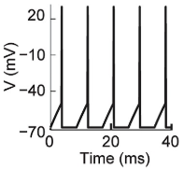

Leaky integrate-and-fire model

Slide 11
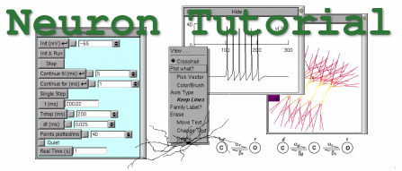
Special project
Program NEURON
Making a tutorial about the program, what can it do, description of steps with illustration
Using it to model a neuron, a neural network
https://neuron.yale.edu/neuron/

